Slide 1
From www.eclipse.org/osee to deployment
Tutorial
Ryan Brooks
Donald Dunne
Roberto Escobar
Boeing
Mesa, AZ

Slide 2
Agenda
Installation & Setup
OSEE
  What is it?
  Background Information
Architecture
  Network Layout
T. Rex Software Company
Data Model
Version Control
Variant Management
Break
Notes:
Hand-out Flash Drives
Ask people to follow readme.

Slide 3
Before we begin…
This is an interactive session: feel free to ask questions
Tell us about yourself
  Background Info
  Operating Systems
Tutorial based on OSEE 0.7.0

Slide 4
Requirements
System Requirements (non-eclipse)
  System with at least 1GB of RAM
  Java Runtime Environment (JRE) 1.6 or higher
  Microsoft Office (For Demo Only)
Eclipse Dependencies
  Eclipse 3.4.2 SDK
  org.eclipse.gef
  org.eclipse.draw2d
  org.eclipse.birt
  org.eclipse.datatools
  The easiest solution is the Ganymede Eclipse install Eclipse IDE for Java and Report Developers

Slide 5
Installation
Database
  Run the PostgreSql installer, located under the “PostgreSql” folder, for your OS using the following settings
    Default install path
    Default data directory
    Password “Postgre1”
    Port 5432
    Default Locale
    On last screen uncheck “Launch Stack Builder”
  Setup database accounts and schemas by executing the bash/bat script for your OS located under the “PostgreSql” folder
    Save db password using pgadmin
    osee_db_setup.bat – Windows
    osee_db_setup.sh – Others
  For more information or for the files mentioned above visit
    http://www.eclipse.org/osee/documentation/installation/postgresql_install.php
Notes:
If you already have postgres installed and wish to uninstall it, you will also want to delete the windows user called postgres using the command: net user postgres /delete
Copy pgpass.conf into <user home>\Applicationdata\postgresql

Slide 6

Installation - continued
JRE
  Ensure the JRE 1.6 is in the path by typing java –version at a command prompt
OSEE Client
  Extract the Eclipse base zip for your OS located under “Eclipse Base” to a short path and then launch eclipse
  From the Eclipse update manager, install the update sites located under “OseeClient”
    org.ecilpse.osee_integration_build_incubation.zip
    osee.add.ons.updatesite.zip

Slide 7
Initialization
Launch Application Server
  Execute the launch script for your OS located under “OseeApplicationServer”
    osee_app_server.bat – Windows
    osee_app_server.sh - Others
  Wait until the server finishes the start up procedure
    Do not close the console
Database Initialization
  In a command prompt change to the eclipse install dir
  Once db init completes, type exit in the server console
eclipsec -application org.eclipse.osee.framework.database.configClient -vmargs -Xmx512m -Dosee.log.default=INFO -Dosee.application.server=http://localhost:8089 -Dosee.authentication.protocol=trustAll -Dosee.prompt.on.db.init=false -Dosee.choice.on.db.init="OSEE Demo Database"

Slide 8
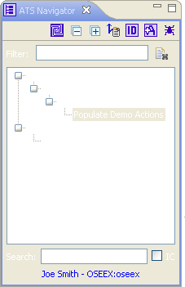
Populate Demo Data
Launch Application Server
Launch OSEE Client
Switch to the ATS Perspective
    Window
    Open Perspective
    ATS
    In the ATS Navigator Window
      Type “Populate” in the Filter text box
      Press ‘Enter’ to add filter
      Double-click on the “Populate Demo Actions” item
      Wait for operation to complete
  eclipse -vmargs -Xmx512m -Dosee.application.server=http://localhost:8089 -Dosee.authentication.protocol=demo

Slide 9
What is OSEE?
OSEE is a tightly integrated environment designed to support lean engineering principles across a product's full life-cycle in the context of an overall systems engineering approach.

Slide 10
Background
OSEE began was first deployed to develop Boeing’s next generation Apache Helicopter
It provides
  An integrated tool set
  End-to-end traceability
  Variant configuration management
  Integrated workflows and processes
  A Comprehensive issue tracking system
  Deliverable document generation
  Real-time project tracking and reporting
  Validation and verification of mission software

Slide 11
Background - continued
As an eclipse project
  Milestones
    Initial source committed on Dec 8, 2007 (~140K LOC)
    Project proposal approved on July 10, 2007
    Test environment framework submitted Spring 2009 (37K LOC)
OSEE is used to engineer itself

Slide 12
Architecture
Initially OSEE was architected as a heavy client
  Direct client-to-database interactions
Migrating into a Thin-Client/Server architecture
  Utilizing OSGI on server-side
  Flexible deployment and maintenance
  Address scalability and load management

Slide 13
Simple Network Layout
OSEE Datastore
Application server has access to the remote file system
Remote File
System
Relational Database
OSEE Application Server
192.168.1.110:8089
Single server acting as an arbitration server
After arbitration, client communicates with application server directly
OSEE Arbitration Server
192.168.1.110:8089
Client connects to arbitration server on start up. This is configured via JVM argument osee.arbitration.server
OSEE Client
192.168.1.200:8012
Notes:
We decided to use a remote file system for binary data storage – relational database performance was a consideration for the decision.
For this demo we are running all components on the same machine.
We can have each system running on a different PC – including the database and the remote file system
Only restriction is that an application server instance must have access to the data store components.

Slide 14
Third-Party Extensions and Legacy Software
Java/C/C++/Ada Dev
Backup/Restore
Multi Configuration
Project Mgmt/Planning
Building/Releasing
Team Config
Workflow Config
Metrics
Rich Traceability
Process Mgmt
Document Mgmt
Requirement Mgmt
Visualization
Blam Operations
Rules Framework
Publishing
Reporting
Messaging
Results Analyzer
Real Time Testing
Unit Testing
Reporting
Security
Task Scheduling
Database Analyzer
Training Services
Exemplary Applications Extensible Frameworks
Application
Development
Configuration
Management
Systems
Engineering
Requirements
Management
Testing
Environment
OSEE Application Framework
GEF
Zest
Plugin Dev Utilities
Extensible Rendering
Remote Event Service
Indexing & Tagging
Dynamic Searching API
Dynamic Artifact Model
Multi-Level Transactions
Multi-Level Branching
Data Store Adapter
Access Control
Version Control
Session Mgmt & Authentication
Object-Oriented Persistence
Web Tools Platform
BIRT
Nebula
CDT
JDT
Other
Eclipse Platform
Java Virtual Machine
JINI (Peer-to-Peer)
OSGI
Relational DB
Operating System (Windows, Linux, OSX, Solaris)
Notes:
OSEE’s Architecture extends the Eclipse Platform and provides it’s own extensions for use by the Applications that are built on top.
OSEE Application Framework provides the services necessary for the applications to share the common data model
Custom, Non-Engineering Environment Applications can be built on OSEE Application Framework and delivered to customers
OR Additional Applications can be plugged in to enhance OSEE’s already existing applications

Slide 15
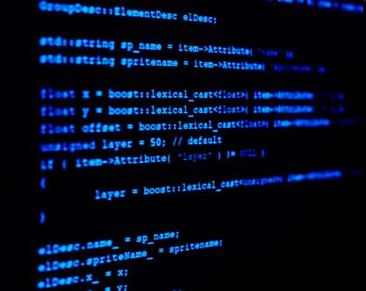
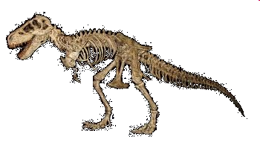
T. Rex Software Company
15 years in the business
Developing software for medical applications
Waterfall development cycle
Isolated teams using disconnected tools to track issues
  Requirements - using spreadsheets
  Code – problem change report database
  Test – spreadsheets and emails
Status is reported weekly via emails to team leads who then flow information to project managers

Slide 16
T. Rex Software Company
Inefficiencies/Cost
  Software license fees
  Steep learning curve
  Data redundancies
  Weak knowledge management
  Issues fall through the cracks
  Poor Planning
  Lagging metrics

Slide 17

SAW-TSR Project
Project with many challenges
Must develop a Surgical Assistant Workstation for Tele-operated Surgical Robots (SAWTSR)
Project was 40% under funded
Stringent requirements on software quality
  Medical application
  Severe consequences of faulty software
Project must meet a company wide initiative to streamline processes
If T. Rex does not make a change, the contract will be lost

Slide 18
Why should T. Rex use OSEE?
Full life-cycle engineering environment
Open source extensible platform
Benefits of eclipse community
Tightly integrated
  Common data model
  Version control
  Change management
  Workflows and processes
  Supports multiple databases
Zero license cost

Slide 19
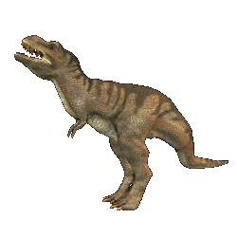
Company is ready to evolve!
Management decides to use OSEE

Slide 20
Where do we begin?
Analyze data produced during life-cycle
  Project produces various files
    System Level Requirements
    Software Level Requirements
    System Requirements
    Source Code
    Test Source
    Test Results
Determine how data relates to one another
Notes:
Windows File Folders
Data Sources

Slide 21
Document Trace
Product Decomposition
SAW
Requirements Traceability
Allocation
Video
Processing
…
Hydraulics
System
Requirement
System
Requirement
Requirement trace
3D
Capture
Control
Health
Subsystem
Requirement
Subsystem
Requirement
Subsystem
Requirement
Allocation
Design
Software
Requirement
Software
Requirement
Subsystem
Design
Implementation
Verification
Code
Unit
Code
Unit
Automated
Test
Test
Procedure
Notes:
Product Decomposition

Slide 22
Understanding the OSEE Data Model
Artifact
  Main OSEE data object consisting of attributes
  Artifact type - blue print for instance creation
  Artifact types can inherit from one another
  All artifacts inherit from “Artifact” (similar to Object in Java)

Slide 23
Attribute
Key / Value pair representing a single data element
Attribute type - blue print for instance creation
Attribute base type is used to convert raw data into a native type or other object
Attribute base types
  String
    Word Templated Content
    Word Whole Document
  Date
  Boolean
  Integer
  Floating Point
  Enumeration

Slide 24
Attribute - continued
Attribute backing data managed by an attribute data provider
  Transfers data between client/server
  Can be extended to serve data from outside OSEE data store
Attribute type also defines whether the attribute is searchable and how to tag the data

Slide 25
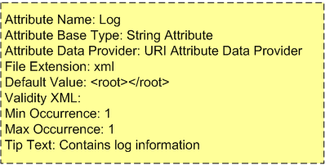
Attribute - continued
Application Server
Application
String Attribute
Base Type
To/From Datastore
Name
Data
URI Attribute
Data Provider
Log
<root>
<log…>
</root>
Attribute Instance
Attribute Type
Notes:
Attribute containing XML data transferred to/from datastore – converted to correct type via base type.

Slide 26
Relation
Relates two or more artifact types
Relation type - blue print for instance creation
  Relation type
    What type allowed on side A
    What type allowed on side B
    Multiplicity (1 to 1, 1 to Many, Many to Many)
Side A
1
*
Side B
Artifact Type
Artifact Type
Default Hierarchical Relation
Parent
Child

Slide 27

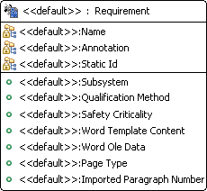
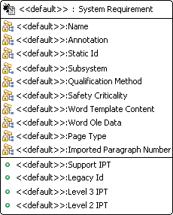
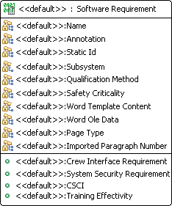
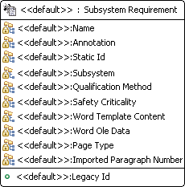
Artifact Types
Inherited Attributes
Inherited Attributes

Slide 28
Artifacts
Simple, User-definable Data Model
Artifact Instance
Software Requirement
Verification Relation
Test Unit
Name: Robot API
Name: Robot API Test
Paragraph Number: 1.1
Source: <Test Code>
Safety Criticality: E
Attribute Instances
Word Content: <……>
Notes:
The main components of the data model are:
Artifact – data objects
Attribute – state data on artifacts
Relations – Link artifacts to one another
All data types are strongly type and user definable

Slide 29
Version Control
Changes to artifacts, attributes, and relations are tracked by the system
Changes are managed by a transaction based version control system using fine grained change identification
Data managed under branches

Slide 30
Transaction
Transaction: 1000019
Timestamp: Mar 2, 2008
Author: Joe Smith
My Requirement
Time
Transaction: 1000020
Timestamp: Mar 3, 2008
Author: Alex Kay
My Requirement
My Code unit
My Test unit
Transaction: 1000021
Timestamp: Mar 4, 2008
Author: Joe Smith
My Requirement
My Code unit

Slide 31
Branch
System Root Branch
Project 1
3
Changes committed in transaction 4
4
Relation Changed
Transactions
Deleted Requirement
5

Slide 32
Variant Management
Product lines share common baseline data throughout all variants
Changes to the baseline product can be easily merged to the variant product lines
Product A
Release 1.0
Release 2.0
Release 3.0
Product A.2 (Product A w/ Additions)
Product A.3 (Product B w/ Additions)
Time

Slide 33
Branching
Branching
  Used to create a variant of the parent branch
  Updates can be performed to obtain changes from the parent branch into the child
A variant branch can be committed back into its parent
  Change conflicts are resolved via merging

Slide 34
Branching - continued
Commit into parent with no conflicts
Conflicts resolved in a merge branch before commit
Working Branch A
Program A
Update Program B with latest changes from Program A
Working Branch B
Merge Branch A
Program B

Slide 35
BREAK

